Slide 1
Apigee Products Overview
Bala Kasiviswanathan
Products
@BalaK

Slide 2
Agenda
How are mobile and devices changing everything?
How is Apigee approaching this challenge to help customers?
How Apigee products can help?

Slide 3







Mobile changes everything

Slide 4








Delivering your services
Employee
Partner
Customer

Slide 5



How do you enable your backend services?
?

Slide 6


Digital Channels and Apigee Edge
Mobile
ESB, SOA,
App Servers,
Databases
Point of Sale
App, API, Analytics Infrastructure
Partner
Backend Services
Web
Apps

Slide 7
Apps, Data, and APIs deliver Choice, Context and Speed
Context
Apps
Data
Digital Assets
Choice
Speed
APIs
Notes:
Main Points:
Mobile is changing everything, especially your customers’ expectations.
How can you meet and exceed these expectations to standout in the marketplace?
You need to deliver choice, shaped by context, and get there with speed.
In the digital world choice is delivered through apps, context is shaped by data and all is connected and catalyzed by APIs.
Apps, Data, and APIs are the building blocks of the transformation your business needs to go through.
The process is called the Digital Transformation.
Mobile is changing everything.
It’s propagating digital technology into all aspects of life.
Your customers/employees have many more choices in how they can interact and transact with you.
They’re on their smart phones and tablets, they’re wearing smart technologies, they’re standing in front of kiosks that are ready to serve digitally.
In today’s digital world, these choices manifest themselves as apps.
Apps have become the store, the branch, the office, the desk, the reality.
Apps are the purpose built environment for you to interact and transact with your customers/users.
Are you where your customers/employees are?
How quickly can you get there?
Digital technology has shifted the speed of decision making into hyper-drive.
To compete, you need the tools of the digital trade.
APIs are the catalyst for the transition to the digital world.
APIs transform your digital assets into innovation engines so that partners and developers can build upon them.
And how do you keep improving and building the next great product or service?
APIs are not just about accelerating app development.
Just as importantly, if not more, they’re about empowering you to connect digitally with your customers, so that you can understand their choices and their context.
When an app asks the user if it can use their location, it’s learning about their physical context and capturing it as data through an API.
When an app asks the user if it can use their social contacts, it’s learning about their logical context and using it as data through an API.
When an app is bringing in historical context about surroundings such as weather and temperature, that’s based on data capture through APIs.
And all this data makes your business more intelligent about its customers in general, but also in ways we’ve never imagined were possible, allowing it to build better products and services in the future.
In today’s digital world choice is delivered as apps, optimized by data and catalyzed by APIs.
Apps, data, and APIs are the building blocks of the digital business.
To compete and thrive, enterprises have to extend their businesses into the digital world.
This process of reinventing business through the use of Apps, Data and APIs is called Digital Transformation.
Supporting Data:
- 72% of the total world population (5.8 billion) will use mobile phones by 2015. (eMarketer)
- 30 Million new smartphone users in the US last year.
- 900,000 iOS apps. 800,000 Android apps.
- App downloads: 50 Billion on Apple App Store. 48 Billion on Google Play.
- Mobile payment transaction volume will reach $630 billion by 2014. (Juniper Research)
- Total value of all types of B2B and B2C transactions will equal $16 trillion in 2013. (IDC)
- 11% of all sales flowing through the world economy.

Slide 8



Digital Value Chain
User
App
Developer
API
API Team
Backend

Slide 9
Apigee Products
Apigee Edge
Powering digital transformations with APIs, developer services, and end-to-end analytics

Slide 10
Apigee Edge
Developer Services
Developer
Engage internal & external developers and monetize APIs
API Team
Analytics Services
Visibility from the app-end to the back-end
Business
User
API Services
Great APIs & apps fast
App
Backend
Notes:
Main Points:
Apigee Enterprise delivers the most comprehensive set of tools to support your Mobile Value Chain.
Script:
API Layer to securely transform backend services to easily consumable APIs to accelerate app development
Developer Layer to enable, engage and transact with your developer community (represented by the gray people graphics)
Data Layer to provide visibility from the app-end to the backend for business and technical teams

Slide 11
Fits with your deployment model: Cloud or on-premises
Cloud service
On-premises
Developer Services
Developer Services
Our Cloud
Analytics Services
Analytics Services
Your
Data Center or Cloud
API Services
API Services
Your
Data Center
or Cloud
Existing Backend
Existing Backend

Slide 12
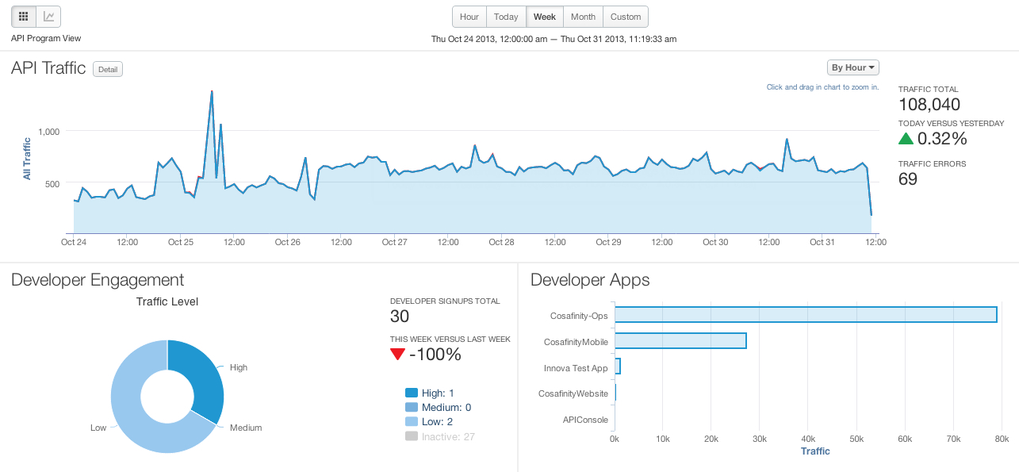
Self service delivers increased productivity for all
Analytics Services
Developer Services
API Services

Slide 13
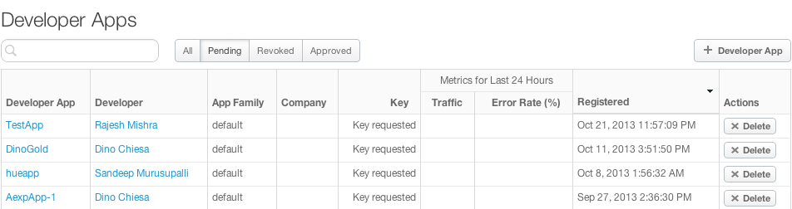
Self service delivers increased productivity for all
Analytics Services
Developer Services
API Services

Slide 14
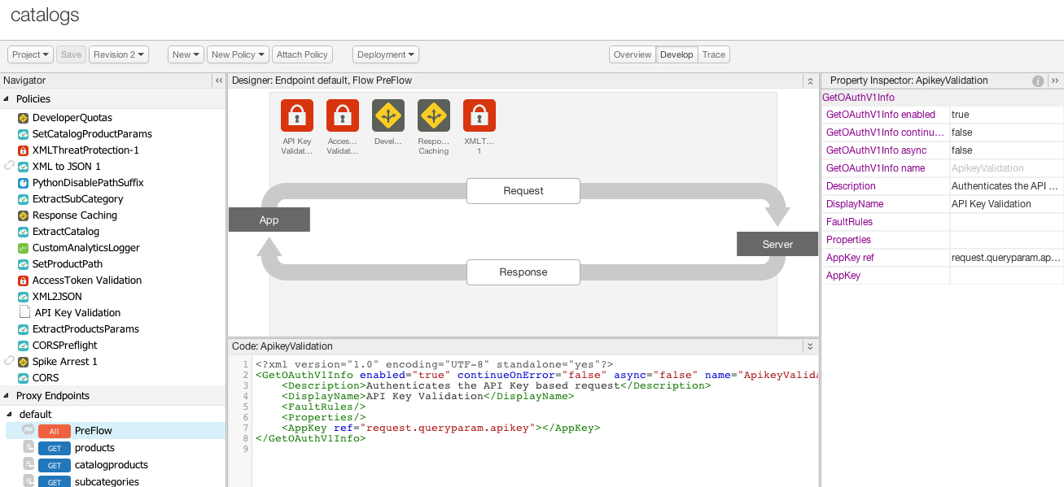
Self service delivers increased productivity for all
Analytics Services
Developer Services
API Services

Slide 15
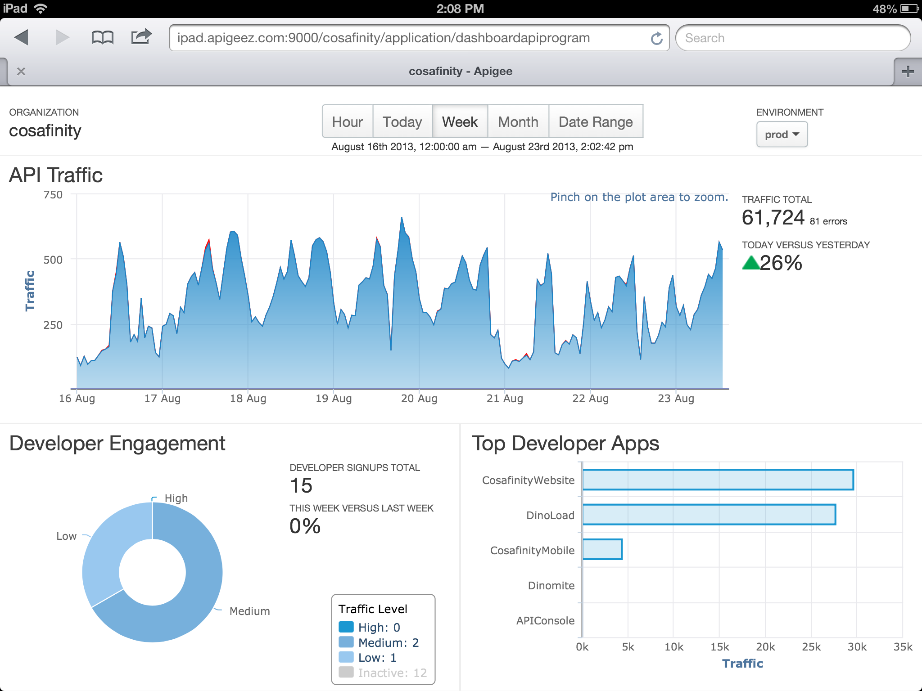
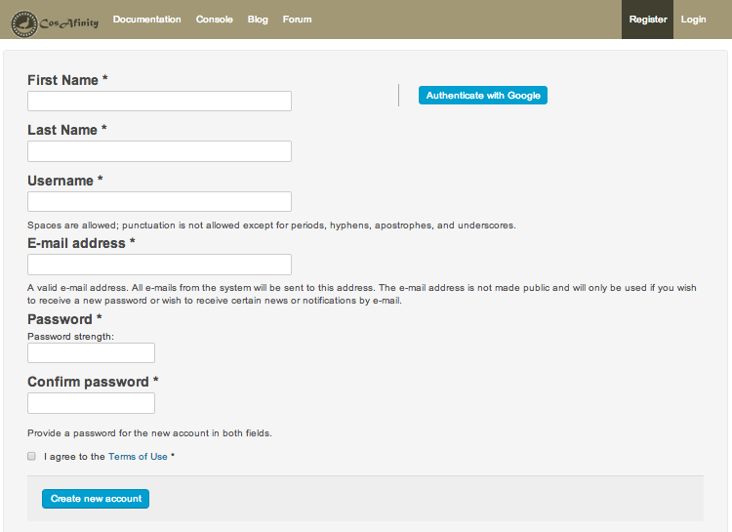
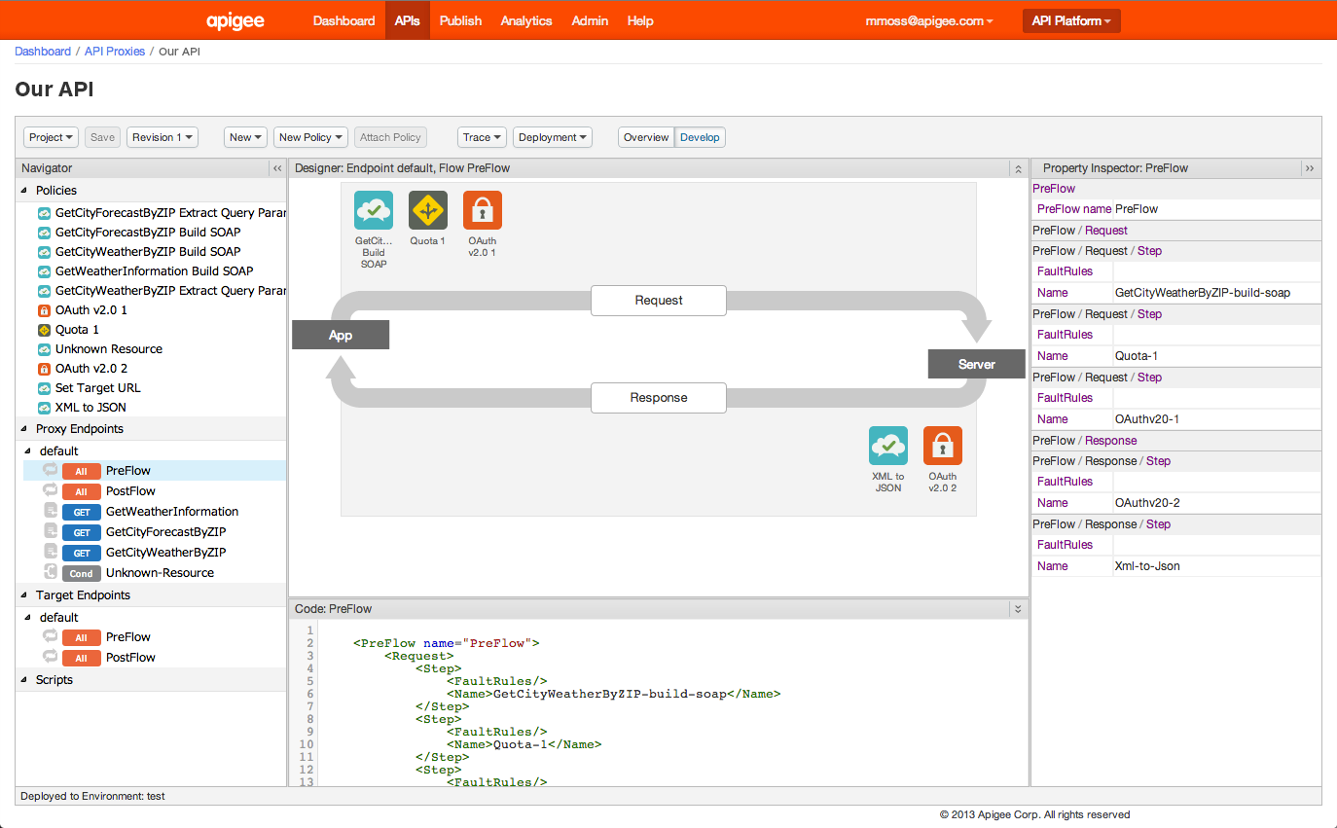
Self service delivers increased productivity for all
Analytics Services
Developer Services
API Services

Slide 16

World-class operations
Global presence
Worldwide network with carrier neutrality and latency optimization
Multi-continent redundancy and distribution network
Operations and support centers around the globe for cloud services and on-premises
True multi-tenancy and HA
Elastic capacity
5-tier Enterprise Cloud Architecture
Zero downtime API upgrades
Round-the-clock monitoring
Real-time and historic API health visibility
API security and compliance tracking
Component and process monitoring
Established
Planned

Slide 17
Apigee Edge
Built for the requirements of the digital economy
Apps, Data and APIs as foundational elements
Deploy in the Cloud or On-premises
Manage via Self Service
Global operations
Multi-region distribution network with true multi-tenancy and HA
Highly scalable, handling billions of API calls per day
Enterprise Security & Compliance: PCI, HIPAA, SOC 2
Unique set of capabilities resulting from customer focus
API Services that enable modern app functionality → great APIs & apps fast
End-to-end Analytics → visibility from the app-end to the back-end
Developer Services with Monetization → APIs delivering top line value

Slide 18






























Digital transformations powered by Apigee

Slide 19
Take it for a spin today!
Apigee Developer

Slide 20
Apigee Products
Apigee Edge
Powering digital transformations with APIs, developer services, and end-to-end analytics
Apigee Insights
Optimize your digital business with insights from contextual analysis of app and API data

Slide 21



Insights: Context driven actions
Action
External Context
Social and other data
Apigee Insights
Internal Context
CRM and other data
All Digital Channels
App Analytics
Apigee Edge
Developer Analytics
Data
API Analytics

Slide 22
Apigee Products
Apigee Exchange
Industry focused API networks for app interoperability
Apigee Insights
Optimize your digital business with insights from contextual analysis of app and API data
Apigee Edge
Powering digital transformations with APIs, developer services, and end-to-end analytics

Slide 23

Apigee Exchange: Solving for fragmentation of digital ecosystems in multiple industries
Apigee Exchange powers industry-wide digital ecosystems
Users
Apps
Developers
API Providers

Slide 24


Apigee Digital Business Platform
Insights
Big Data
Mobile
ESB, SOA,
App Servers,
Databases
Point of Sale
Edge
Apps, APIs, Analytics
Partner
Web
Backend Services
Apps
Exchange
API Networks

Slide 25
Sessions in the Product Deep Dive Track

Slide 26
Session Details
Nov 5, 2013
Nov 6, 2013
API Services: Building State-of-the-Art APIs
API Services: Harness the Power of Enterprise Infrastructure
Apigee Edge:
API Services
API Services: Building Apps That Stand Out
Apigee Edge:
Developer Services
Developer Services: Making Developers Successful
Apigee Edge:
Analytics Services
Analytics Services: Measure Everything, Everywhere . . .
Apigee Insights
Apigee Insights: Data & Context-Driven Actions
Apigee
We Built this City: An Inside Look at the Apigee Cloud

Slide 27
We would love your feedback!
Don’t forget to fill out the session’s survey – found in the session details on the conference app
#iloveapis

Slide 28
Questions

